Slide 1
MCAS Miramar
Natural & Cultural Resources
Presented by MCAS Miramar Natural Resources Division
Notes:
Welcome Aboard Marine Corps Air Station Miramar. At Miramar, the public has entrusted us with carrying out operations to protect national security. As we perform this mission, we must protect our environment and maintain an awareness of the natural and cultural resources to protect them for future generations. This training will walk you through information you need to know. IF IN DOUBT, ASK!

Slide 2
Our Natural Resource Mission
To support the operational requirements of units operating on MCAS Miramar by:
To ensure compliance with federal laws and regulations regarding natural and cultural resources.
To uphold the guidelines and policies in Marine Corps Order P5090.2A: Environmental Compliance and Protection Manual
To provide information, expertise and awareness regarding conservation of natural and cultural resources.
Notes:
MCAS Miramar has an Environmental Management Department or EMD ready to provide support to the Marine Forces by ensuring that all environmental laws are followed, Marine Corps guidelines are upheld and making certain that Marines understand the environmental conservation concerns on the installation.

Slide 3
Primary natural and cultural issues at MCAS Miramar
Conserving and Protecting:
Sensitive Habitat for Threatened and Endangered Species
Streambed (Riparian) Areas
Vernal Pools
Pre-historic & Historic Sites
Providing information, expertise and awareness of natural and cultural resources at MCAS Miramar
Notes:
There are two main topics of conservation awareness at Miramar. First, we must protect conserve the natural resources the public has entrusted to us. Several sensitive, threatened, and endangered species call MCAS Miramar home. Second are areas that are culturally significant such as archeological and historic sites.

Slide 4
Preserving and Protecting
Left to Right
Coastal Scrub Habitat for threatened species
Streambed (riparian) areas
Vernal pools
Pre-historic & historic sites
Notes:
MCAS Miramar’s natural landscape is dotted with a variety of unique resources. On the left is coastal scrub, a habitat once common to Southern California that is now significantly reduced due to continued land development. It supports a federally threatened bird on MCAS Miramar. Avoid damage to shrub plant species during your operations. Streams, and the rich ecosystems they support, must conserved. Pollutants from human activity can enter streams polluting our oceans downstream, which negatively impacts plant and animal species that require clean water. Vernal pools are shallow wetlands that pond during the rainy season in San Diego. They support a thriving ecosystem - home to multiple endangered plant and animal species, such as the endangered San Diego Fairy Shrimp. Damage to vernal pools must be avoided. Other areas of the installation may be cordoned off due to their archaeological or historical significance or temporarily during restoration work. Conduct your activities so that none of these resources are negatively impacted.

Slide 5
Environmental Laws
Laws most applicable to MCAS Miramar natural and cultural resources:
National Historical Preservation Act
Archaeological Resources Protection Act
Endangered Species Act
Migratory Bird Treaty Act
Clean Water Act
Notes:
The Marine Corps is required to follow several environmental and historical preservation laws that are applicable to all federal agencies. Many of these laws were enacted in the 1970s and established to protect human health, environment, and historical sites in the country. Failure to follow these laws can be costly to the Marine Corps mission by means of operational delays, restoration costs, and monetary fines. We will further elaborate on some of these laws and how they will affect your operations.

Slide 6
Endangered Species Act
GENERAL INFORMATION
Any operations or training in natural areas of on the station must be approved through the Public Works or Training Area Mgmt Office in coordination with EMD.
“Taking” of a threatened or endangered species is prohibited.
“Taking” means “harass, harm, pursue, hunt, shoot, wound, kill, trap, capture, or collect, or attempt to engage in such conduct.”
Penalties for ESA violations can include fines up to $200,000 and 1 year imprisonment per take.
Notes:
The Endangered Species Act, is a federal law that protects plant and animal species from extinction. MCAS Miramar has 10 species eligible for protection under this statute. It’s important that all personnel working aboard the installation do their best to avoid “taking” them. Avoid “taking” violations by planning ahead with station S-3, S-4 and EMD for all training, special events, or building modifications, or fitness/recreational activities. Off-roading is not authorized anywhere on Station. “Taking” is defined as harassing, harming, pursuing, hunting, shooting, wounding, killing, trapping, capturing, collecting or attempting to engage in such conduct. Adverse modification of occupied habitat that makes it unsuitable has been interpreted as “harming” such species.

Slide 7
Vernal Pools
GENERAL INFORMATION
A type of wetland that hosts unique and endangered plant and animal species.
Water only present during rainy season.
During wet season, fairy shrimp lay eggs in vernal pools which settle into soil at bottom. Eggs stay in the soil throughout the dry season. Once the wet season return, eggs will hatch.
Driving through vernal pool areas can spread the fairy shrimp eggs to other locations, putting further training restrictions on Marines.
Notes:
Vernal pools are ephemeral, meaning that they only occur during certain times of the year. The winter rainy season is the time of the year when vernal pools are most apparent because they pond water. Fairy shrimp are the most commonly noted species to inhabit vernal pools, but vernal pool habitat on MCAS Miramar also supports four threatened or endangered plants. Every year when water fills up the vernal pool depressions, fairy shrimp hatch, live out their life cycle and lay eggs which deposit in the soil to help future generations of fairy shrimp proliferate. Fairy shrimp eggs can be dispersed into new areas of the Station by transporting mud from pools they occupy to other puddles and ponded sites. All sites occupied by endangered fairy shrimp must be protected, so spreading their eggs can limit our land use. Remember that off-roading is never permitted.

Slide 8
VERNAL POOLS (Wet Season)
Notes:
Let’s take a look at one of the most critical habitats on the installation. Pictured here is a typical vernal pool during San Diego’s wet season. Vernal pools are seasonal wetlands resembling small shallow pools that form during the winter through spring rainy season. Approximately 97% of these vernal pools have been destroyed in San Diego County. The Marine Corps is responsible for ensuring that the 127 acres of vernal pool wetland habitat at MCAS Miramar is protected.

Slide 9
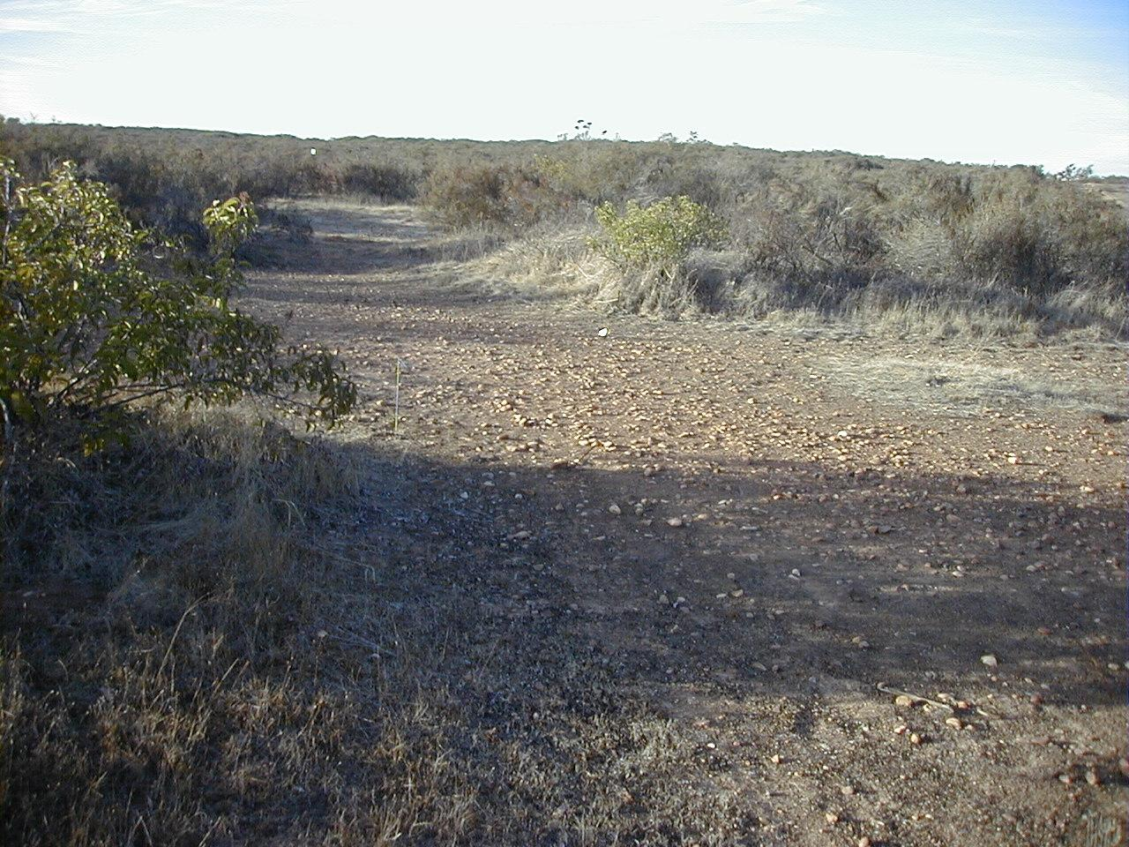
VERNAL POOLS (DRY season)
Notes:
Here is a photo of the same vernal pool that was shown in the previous slide. During the summer, vernal pools dry up and appear as bare or sparsely vegetated basins. Other dried up vernal pools are not as obvious however and can simply appear as flat dirt areas or possibly roads. Off-roading is never permitted. Keep vehicles on established roads.

Slide 10
VERNAL POOL HABITAT DESTRUCTION
Development
Off-road vehicle activity
Concentrated foot traffic
Other ground disturbing activities
Notes:
MCAS Miramar puts a lot of effort into protecting and maintaining the ecological integrity of vernal pools. Vernal pools are on the decline due to development, off-road vehicle activity, concentrated foot traffic and other ground disturbing activities. The easiest way to help preserve these sensitive ecosystems is to avoid all interaction with them.

Slide 11
Notes:
This map of MCAS Miramar shows the extent to which vernal pools and vernal pool watersheds cover the installation. Vernal pools occur throughout the western half of the Station where the land is relatively flat. Relatively undeveloped areas have the highest densities of vernal pools. Never go off-roading, especially during the winter rainy season.

Slide 12
Least Bell’s Vireo
(Federally Endangered)
San Diego Fairy Shrimp (Federally Threatened)
Willowy Monardella
(Federally Endangered)
California Gnatcatcher
(Federally Threatened)
Notes:
Several endangered or threatened animal and plant species call Miramar home. Of all of the species at Miramar, the species most likely to affect our activities is the San Diego Fairy Shrimp, pictured above. This is because of its abundance around our flightline and other undeveloped land on the western half of the Station. The MCAS Miramar Sensitive Resources Map is the best source for up-to-date information regarding the distribution of all threatened and endangered species on the Station (WE NEED ANOTHER SLIDE THAT PRESENTS OUR SENSITIVE RESOURCES MAP AND TELLS FOLKS THAT IT CAN BE FOUND AT A LINK ON THE NATURAL RESOURCES EMS WEB PAGE. I have added a suggested start, but it is not yet “polished”).

Slide 13
Migratory bird treaty act
GENERAL INFORMATION
It is unlawful to pursue, hunt, kill, capture, possess, sell, purchase or barter any migratory bird; including their feathers, nest or eggs.
Violators face potential penalties including fines and imprisonment.
Exceptions include special purpose permits and authorized hunting seasons.
Notes:
There are many bird species that inhabit MCAS Miramar lands. Do your best to ignore birds and let them be. If birds are endangering themselves, harming operations, or otherwise being a nuisance to humans, please contact the Natural Resources Division of EMD for assistance. You should never pursue, hunt, kill, capture, possess, sell, purchase or barter any migratory bird without a federal migratory bird permit or during federal and state approved hunting seasons. Violators face potential penalties including fines and imprisonment.

Slide 14
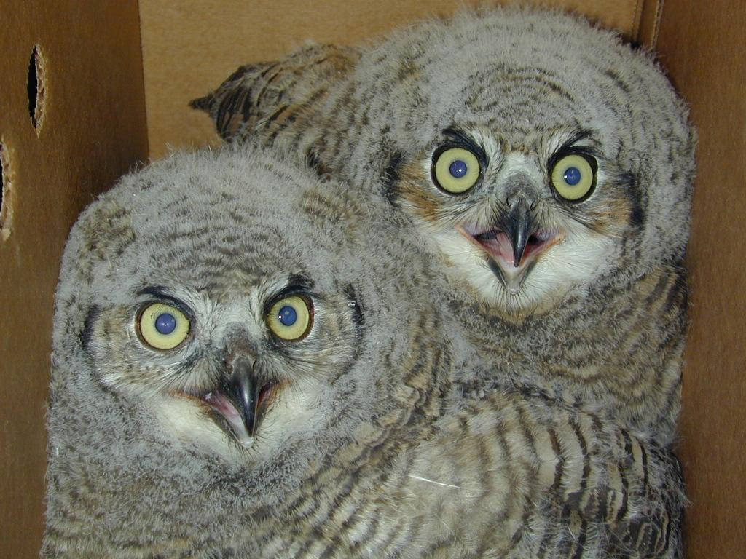
Preclude Bird Nesting Problems
The Migratory Bird Treaty Act protections cover active bird nests.
Take measures to prevent bird nesting where incompatible with operations.
If a bird nests contains eggs or young, it must be left alone until the young have flown away.
Notes:
Migratory birds and their nests are protected by the Migratory Bird Treaty Act making it illegal to harass or harm birds or their nests. Consult with the environmental department to determine the best method to prevent birds from nesting at your sites. In many cases, such as the case with swallows, deterrents can be affixed to the eaves of buildings to prevent birds from building nests there. However, once a bird nest has been established, it is unlawful to remove it.

Slide 15
Historic Sites
Pre-historic and historic sites at MCAS Miramar
9 sites appear eligible for listing on National Register of Historic Places
All archaeological/ historic sites are off-limits.
Notes:
There are historical sites at MCAS Miramar, such as the one pictured above. This cemetery was associated with the former Linda Vista community during the 1890s to about 1912. There are no military personnel buried here according to our current evaluations.
All archaeological sites of historical significance are strictly off-limits to disturbance. If you happen to find any pre-historic or historic artifacts during your operations in the field, please leave the artifacts where you found them and notify Miramar’s Environmental Management Department.

Slide 16
Archaeological resources protection act
GENERAL INFORMATION
Prohibits the unauthorized excavation, removal, damage, or trafficking of historical or archaeological materials
Penalties to individuals could include fines up to $100,000 and 5 years imprisonment.
If you find archaeological artifacts, leave them there and notify Miramar’s Environmental Management Department
Notes:
The Archaeological Resources Protection Act prohibits the unauthorized excavation, removal, damage, or trafficking of historical archaeological materials. Any failure to follow this law can put individuals at risk for fines of $100,000 and imprisonment of up to 5 years. When conducting operations or training out in the field, never DISTURB A SUSPECTED historical or archaeological sites. If you do happen to find artifacts during your field work, leave the artifact alone and notify the Environmental Management Department so that they can take the appropriate course of action.

Slide 17
National historic preservation act
GENERAL INFORMATION
NHPA establishes requirements for designating and protecting historic structures and resources potentially eligible for inclusion on the National Register of Historic Places (NRHP).
NHPA made up of three stages:
Identify and evaluate any impacts to historical resources.
Determine the effects on those historic resources
Develop measures to avoid or mitigate adverse effects.
Notes:
The National Historic Preservation Act (NHPA) establishes requirements for designating and protecting historic structures and resources potentially eligible for inclusion on the National Register of Historic Places. The act is comprised of primarily three stages. First, you must identify and evaluate any impacts to historical resources such as historical buildings or burial sites. Second, you must determine the effects on those historic resources. And finally, measures to avoid or mitigate adverse effects must be developed.

Slide 18
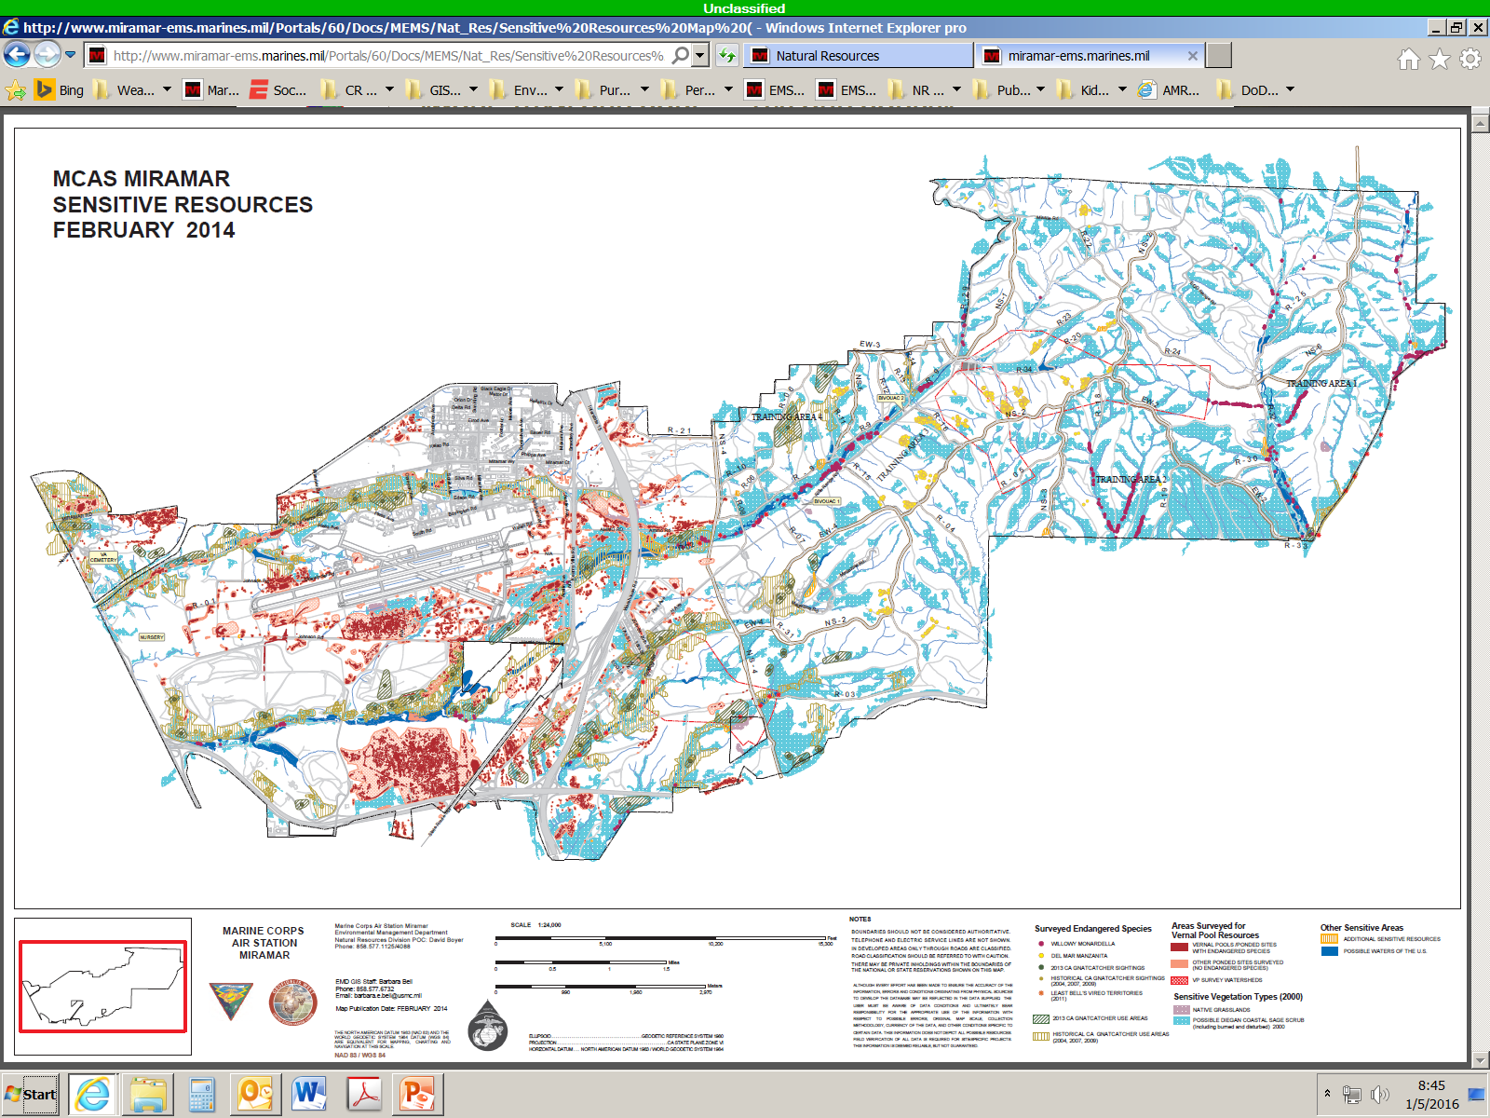
http://www.miramar-ems.marines.mil/Divisions/NaturalResourcesDivision/NaturalResources.aspx
Notes:
We encourage you to visit www.MiramarEMS.com to find additional learning materials about Miramar’s robust natural resources program. Be sure to view our Sensitive Resources map which is available on the natural resources page.

Slide 19
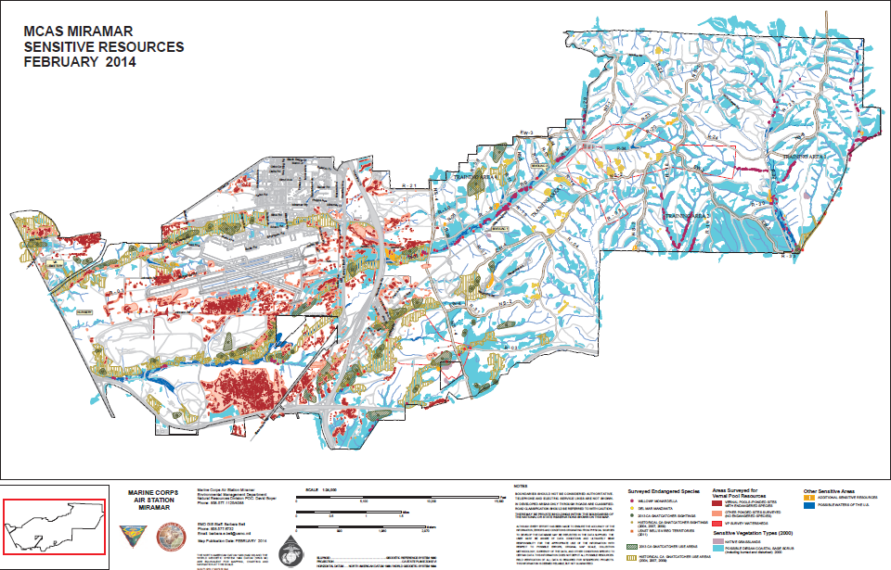
Notes:
The environmental division has identified the following color coded zones as sensitive areas of biological significance. Red areas represent vernal pools, blue areas represent areas of Sage Scrub habitat and purple areas represent protected native grasslands. For a high resolution map with zoom in and out capabilities, be sure to visit the Miramar EMS Webpage.

Slide 20
Hazardous plants and animals
Notes:
Some animal and plant species on MCAS Miramar can present hazards to Marines working on the installation. Rattlesnakes, coyotes, bees, skunks, raccoons, and poison oak should be avoided whenever possible. Species do not remain in only in open spaces and may encountered in the urban areas. They are searching for food, shelter, water or suitable places to live. Keep areas clean, neat, and inspected on a daily basis. Contact the Public Works Trouble Desk at 577-1619, for safe wildlife removal.

Slide 21
Rattlesnakes
Two rattlesnakes occur on MCAS Miramar
Coils up before striking
Generally aggressive only when approached
Bites can cause hemorrhaging, intense pain, and even death, if not treated
Notes:
There are two species of rattlesnake that occur on MCAS Miramar: the red diamond rattlesnake and the southern Pacific rattlesnake. One of these two species can be found just about anywhere on Station. Rattlesnakes are venomous and present a significant hazard to anybody who is bitten. Seek immediate medical treatment for bite victims. Use caution when walking through brush, next to piles of debris, along the sides of roads or dense cover. If you get too close to a rattlesnake, the snake will typically warn you with a rattle. Rattlesnakes that feel threatened will continue to rattle and coil up so that they can prepare to strike, if the threat gets too close. Rattlesnakes will typically not seek out conflict, but they will stand their ground and strike if they feel threatened. It is best to give the snakes space and move on; however if their presence is incompatible with operations, contact the Public Works Trouble Desk at 577-1619 for removal assistance. Secure the area and keep visual contact with the snake as long as a threat exists and/or assistance arrives.

Slide 22
POISON OAK
Has three-leaf clusters.
Range in color from red to green depending on season.
Most often found in shrub form in bottom land areas.
Urushiol oil from plant can cause rash and severe itching.
Even dead or fallen leaves and bare stems can cause rash
Notes:
Poison oak is a plant species common to the western U.S. While having a similar leaf shape to normal oak leaves, poison oaks leaves have slightly less pronounced points. Poison oak is commonly found in shrub form, which is why it’s easy to accidentally contact the plant. Wash skin, clothes, materials (equipment, rags, toys, etc.) thoroughly with warm or hot water and detergent.

Slide 23
POISON OAK
If exposed:
Wash exposed skin in warm water and soap.
Wash all clothing that has come into contact with the plant.
Apply calamine lotion or topical steroid to the skin to relieve symptoms.
Notes:
If you are unlucky enough to have a brush with this plant, simply wash the area with warm soapy water and apply calamine lotion or a topical steroid to relieve itching. Again, the plant can be identified as seen in the picture here. More often than not, the plant will have 3 leaves in a cluster.

Slide 24
BEES
Africanized honey bees have been found in county but not problematic.
Found in suitable cavities (trees, ground, old buildings, and when swarming).
Keep an eye out for hives and give them space.
If attacked, run away and seek shelter inside.
Notes:
Bees are a part of our environment that we must learn to live with. Be vigilant and aware of your surroundings whenever conducting outdoor activities for concentrations of bees as well as other concerns. While Africanized honey bees have been identified in San Diego county, cases of very aggressive bees are uncommon. At times, bees can be found creating hives and flying in large swarms. When swarming, bees are at the least dangerous time in their life cycle. Flying swarms or swarms attached to structures are searching for a new permanent home. Swarming bees are full of honey they are carrying that honey to a new home, and almost never sting even when touched. Bees coming and going from well established hives are much more likely to sting, especially if their hives are disturbed. Honey bees are more often encountered in and adjacent to urban areas than undeveloped areas. Contact the Public Works Trouble Desk at 577-1619 if you find hives that present a risk to humans. Call 911 if someone you are with is stung and has an allergic reaction or is know to be allergic to bees.

Slide 25
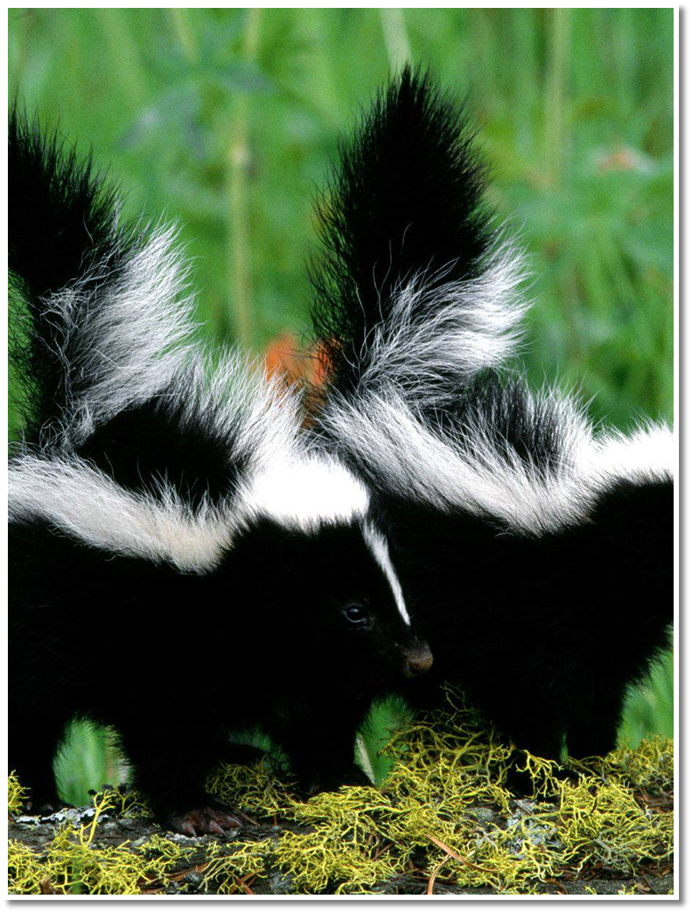
RACCOONS,
COYOTES, and
SKUNKS
Never approach a wild animal even if it seems harmless.
Most wildlife typically avoid humans.
May attack/bite if feeling trapped or cornered.
Some carry rabies.
Wildlife is attracted to food left in and around garbage bins.
Keep your work areas clean
Notes:
These animals are generally not hazardous and are inclined to a wary disposition of humans. However, they can become unexpectedly aggressive, especially if they are scavenging for food or if they are infected with rabies. Rabid animals can attack and bite humans in some cases, passing the virus to victim. Never approach a wild animal such as a pet. Be sure to clean up your work areas and dispose of any trash into the proper receptacles and ensure that trash dumpsters are closed. Maintaining a clean work environment will prevent your work sites from being attractive to wildlife.

Slide 26
FINAL TAKEAWAYS
Protect and be mindful of the natural and cultural resources at MCAS Miramar.
Be aware of your surroundings and understand the unique natural circumstances of your environment.
MCAS Miramar Natural Resources Division staff may be contacted at (858) 577-1125/6426/6498/1108.
Notes:
There are really two final takeaways to remember from this training. 1. Protect and be mindful of the natural and cultural resources at MCAS Miramar. Make as little impact as possible. 2. Always be aware of your surroundings and understand the unique circumstances of your environment, natural or man-made. If you have questions or need more information contact the MCAS Miramar Natural Resources Division staff.

